Slide 1
Basic Wave Properties Notes
Waves are caused by a disturbance which propagates and carries energy.

Slide 2
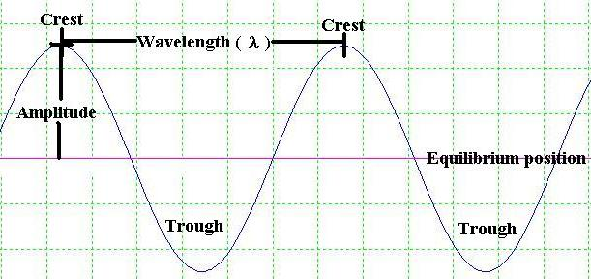
Basic Wave Properties

Slide 3
Wave Velocity
A wave moves along with a certain velocity.
  Recall velocity = distance / time
Wave velocity: v = λ/T
  λ = wavelength (m)
  T = Time period for one wave

Slide 4
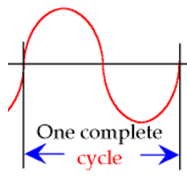
Time and Frequency
Time period (T) = time for one wave to pass by or the time for one complete cycle
Frequency is the # waves/sec. (waves/sec or cycles/sec, also called a Hz)
T = 1/f

Slide 5
Basic Wave Properties
So, v = λ/T = λ x f
T = 1/f
Bird Example
  A bird flaps its wings 3 times per second (= 3 hz).
  So the frequency is 3 hz.
  The bird’s flapping Time period T = 1/3 sec = how long it takes the bird to make one flap.

Slide 6
Wave Calculation
v = λ x f = λ / T
The speed of sound is about 330 m/s. If you hear a sound wave with a frequency of 440 hz, what is the wavelength?
  λ = v/f = 330m/s / 440hz = .75m

Slide 7
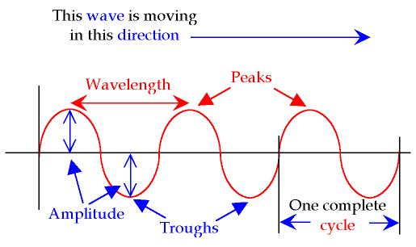
Transverse waves
Transverse waves: a wave in which the disturbance is up/down as the wave moves forward. An ocean wave is transverse.

Slide 8
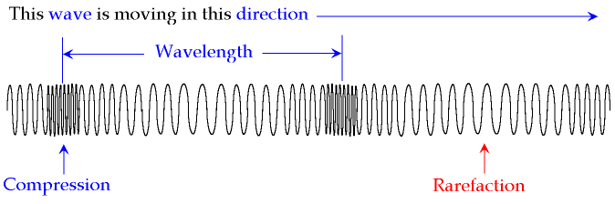

Longitudinal waves
A longitudinal wave is a wave in which the disturbance is in the same direction as the wave is moving. A sound wave is the most common example.

Slide 9
